Slide 1
ICU Prediction Model: Enhancing Patient Care with Machine Learning
An Exploratory Data Analysis and Predictive Modeling Approach
Date: 08/08/2024 Presented by: Mahamadou Mahi Diallo

Slide 2
Introduction
Objective:
To develop a predictive model for ICU admission using patient visit data.
To provide actionable insights to help save lives through early intervention.

Slide 3
Dataset Overview
Description:
Rows: 1,925
Columns: 231
Key Attributes:
Patient demographics (age, gender)
Disease groupings
Medical metrics (e.g., blood gases, albumin levels)

Slide 4
Data Preprocessing
Steps Taken:
Handling Missing Values: Imputation using median for numeric and mode for categorical variables.
Encoding: Categorical variables were converted to factors.
Feature Selection: Recursive Feature Elimination (RFE) identified key features for modeling.

Slide 5
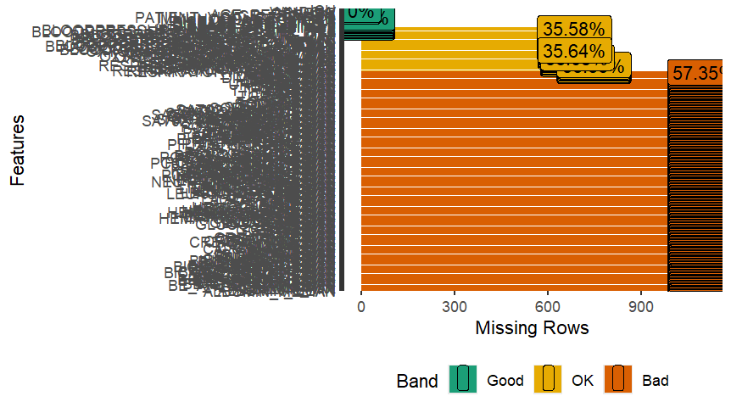
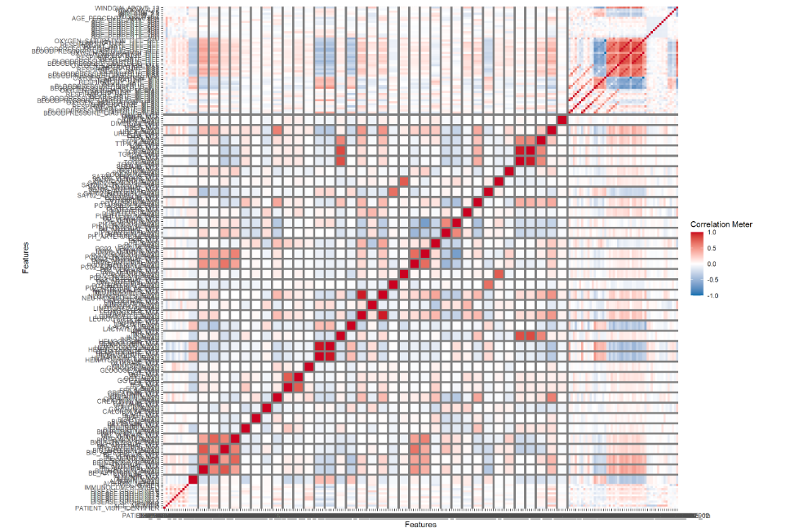
Exploratory Data Analysis (EDA)
Visual Insights:
Missing Values:
A significant amount of missing data in medical measurements.
Visualized using plot_missing(dataset).
Distribution of Numeric Variables:
Histograms to understand distribution patterns.
Visualized using plot_histogram(dataset).
Correlation Analysis:
Heatmap of correlations among numeric variables.
Visualized using plot_correlation(dataset).
Categorical Variables:
Bar plots showing frequency distribution.
Visualized using plot_bar(dataset).

Slide 6
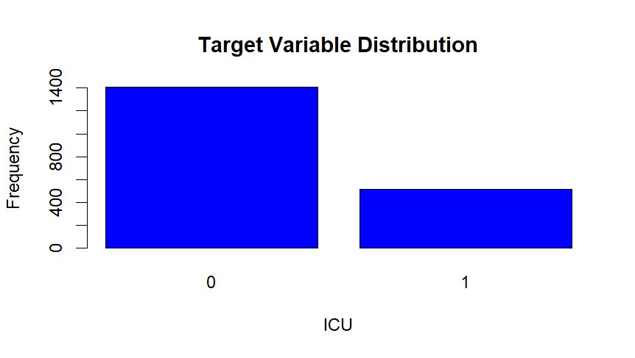
Target Variable Balance
Target Variable: ICU (0 - Non-ICU, 1 - ICU)
Distribution:
Non-ICU: 1,410
ICU: 515

Slide 7
Feature Selection
Key Selected Features:
Respiratory Rate
Blood Pressure
Lactate Levels
Age, Gender, Disease Groupings

Slide 8
Model Development
Models Evaluated:
Random Forest
Support Vector Machine (SVM)
Hyperparameter Tuning: Grid Search with Cross-Validation

Slide 9
Model Performance: Random Forest
Training Accuracy: 97.14% Test Accuracy: 85.97% Kappa (Test): 0.603 Confusion Matrix (Test):
Sensitivity: 0.961
Specificity: 0.5825

Slide 10
Model Performance: SVM
Training Accuracy: High Test Accuracy: 86.23% Kappa (Test): 0.622 Confusion Matrix (Test):
Sensitivity: 0.947
Specificity: 0.631

Slide 11
Overfitting Analysis
Random Forest:
Training Accuracy: 97.14%
Test Accuracy: 85.97%
Observation: High training accuracy with a drop in test accuracy indicates overfitting.
SVM:
Training Accuracy: High
Test Accuracy: 86.23%
Observation: Better generalization with comparable test accuracy.

Slide 12
Summary and Recommendations
Summary:
Both Random Forest and SVM models showed promising results.
SVM slightly outperformed Random Forest in balanced accuracy.
Identified trends in patient data could assist in early ICU admission prediction.
Recommendations:
Implement the SVM model for real-time ICU admission prediction.
Further refine data preprocessing to reduce overfitting.
Continuously monitor model performance and update with new data.

Slide 13
Conclusion
Impact:
Early prediction of ICU admissions can significantly improve patient outcomes.
Our model provides a robust tool for healthcare professionals to make informed decisions.
Next Steps:
Pilot the model in the hospital's ICU.
Gather feedback and refine the model based on real-world performance.

Slide 14
Questions and Discussion
Open Floor:
Any questions or concerns?
Feedback and suggestions for further improvement.

Slide 15
Thank You
Contact Information:
Mahamadou Mahi Diallo
cheickmahidiallo@gmail.com
+1(213)588-9931

